Slide 1
Second and Higher order Ordinary Differential Equation
Introduction to Linear second and higher order
ordinary differential equation
Homogeneous differential equation
Superposition Principle

Slide 2
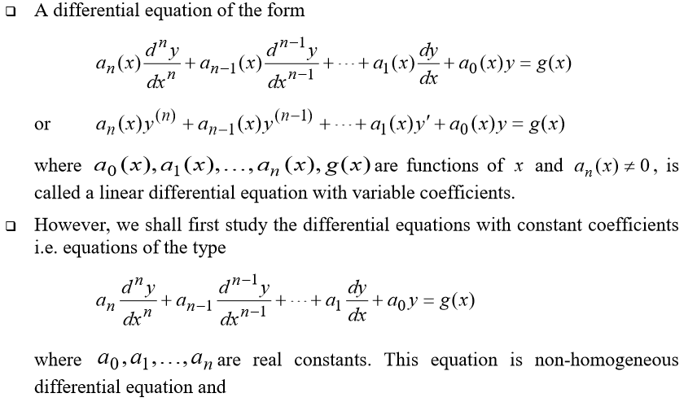
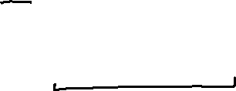
Preliminary theory

Slide 3

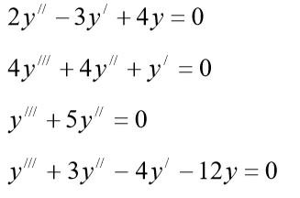
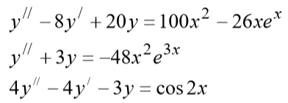


Homogeneous DE
Non-Homogeneous DE

Slide 4
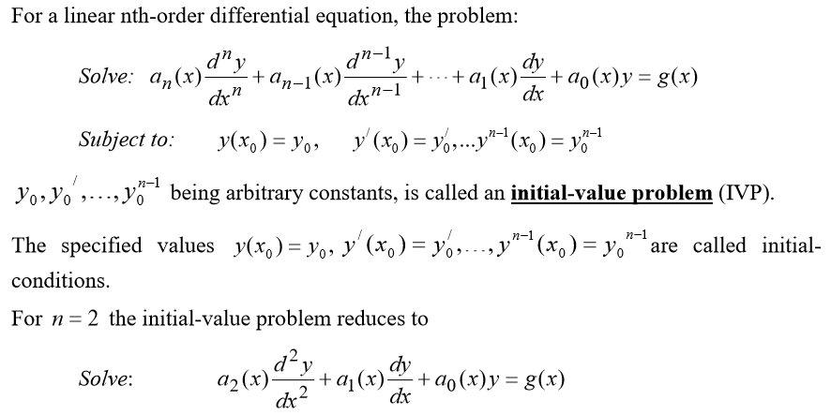

Initial -Value Problem

Slide 5

Theorem ( Existence and Uniqueness of Solutions)

Slide 6
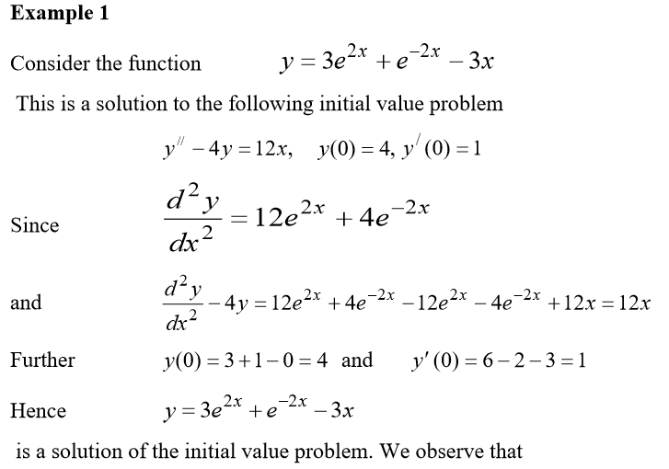

Slide 7

Superposition Principle

Slide 8


Slide 9
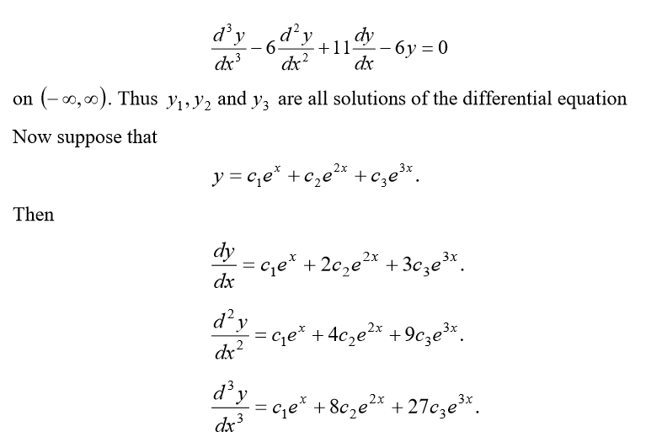

Slide 10
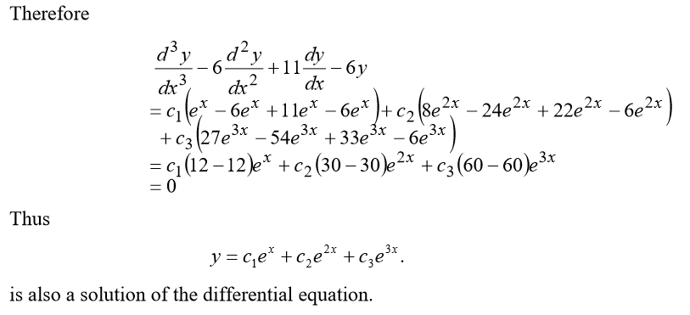

Slide 11


Slide 12
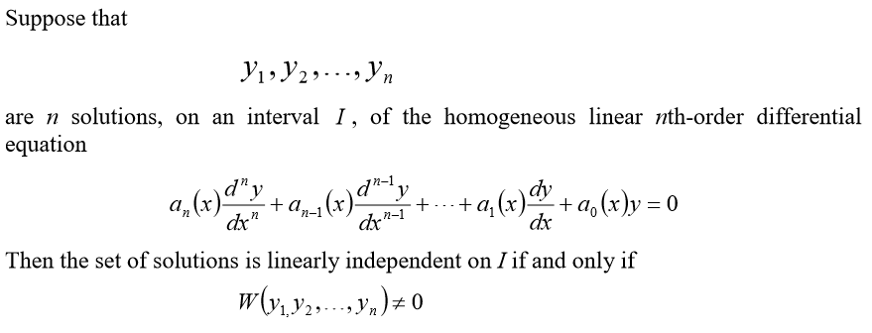
Linear Independence of Solutions

Slide 13
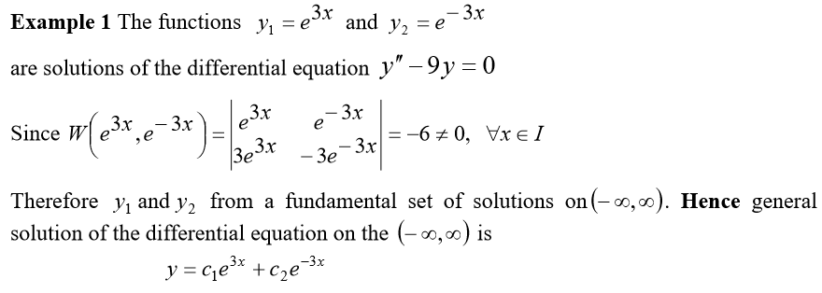

Slide 14

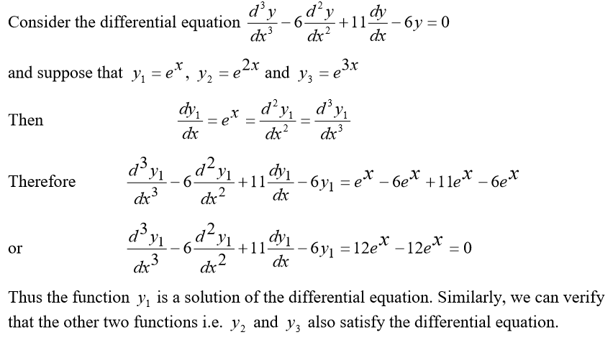

Slide 15

